Slide 1
Incremental Timing-Driven Placement With Approximated Signoff Wire Delay and Regression-Based Cell Delay
Presenter: Chien-Yi Yang
IEEE Trans. VLSI Syst, VOL. 27, OCTOBER 2019
Tai-Cheng Lee and Yih-Lang Li
The Electronic Design Automation Laboratory
Graduate Institute of Electrical Engineering
National Taiwan University
Taipei 106, Taiwan

Slide 2
Outline
Introduction
Algorithms
Experimental Results
Conclusion

Slide 3
Outline
Introduction
Algorithms
Experimental Results
Conclusion

Slide 4
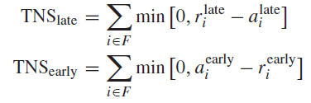




Circuit Timing Measurement
Total Negative Slack
r: required time, a: arrival time
Worst Negative Slack
Net Delay (Elmore Delay)
k: 1 or 0.69
Net Delay After Movement

Slide 5
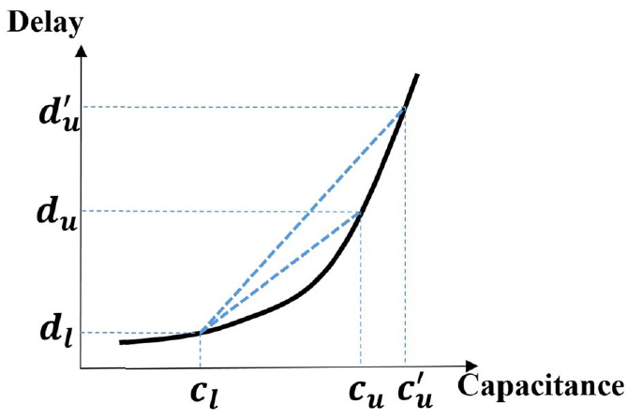



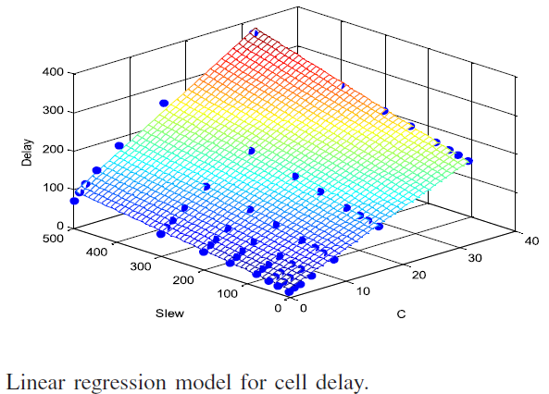

Circuit Timing Measurement
Input Slew After Movement
Cell Delay After Movement
Model Construction

Slide 6
Outline
Introduction
Algorithms
Proposed Flow
Dynamic IR drop prediction
Dynamic IR drop aware cell movement
Experimental Results
Conclusion

Slide 7
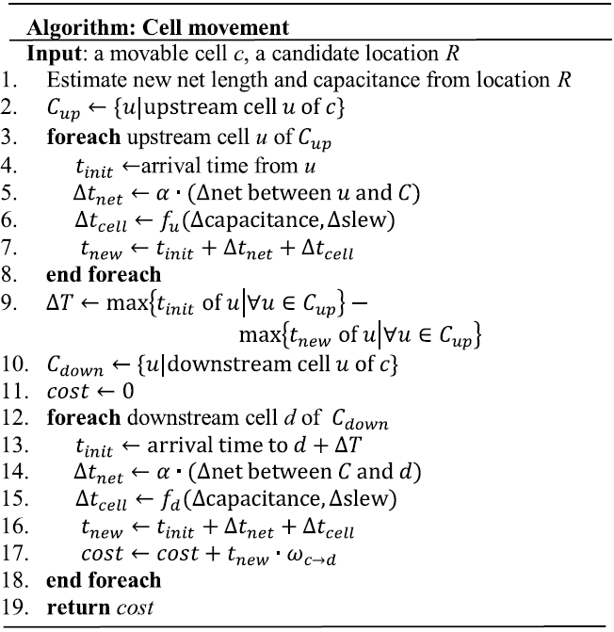
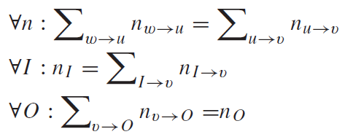
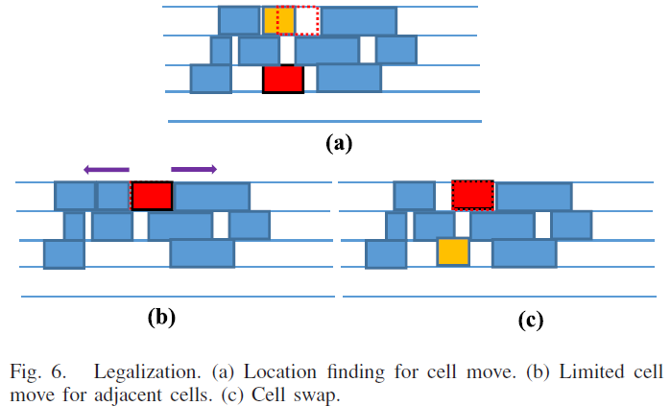
Design Flow With Violation Path-Based Net Weighting
Lagrangian Relaxation
Constraints
Candidate Selection

Slide 8
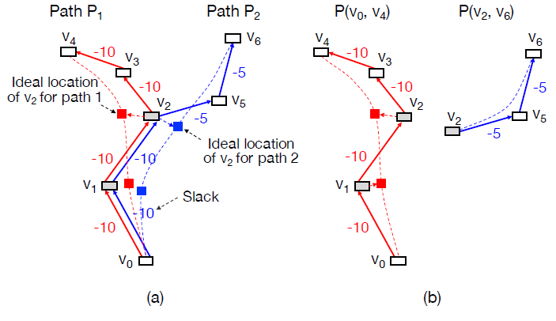
Clock Tree Adjustment
Ideal Space Competition
Figure(a)
Segmentation
Decompose into the critical path and the others
Figure(b)

Slide 9
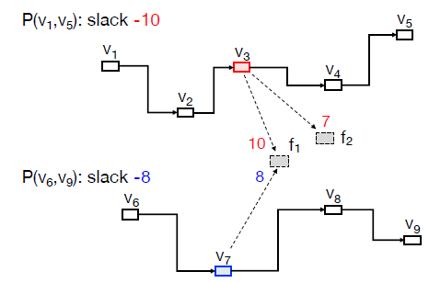
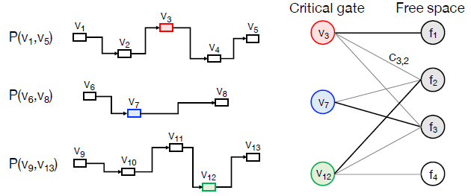
Free Space Assignment for Multiple Gates
Different Cells in different paths compete for the same free spaces
v3 and v7 compete for f1 and f2
Maximum Flow Problem
Construct a bipartite graph
Use Hungarian method to solve it

Slide 10
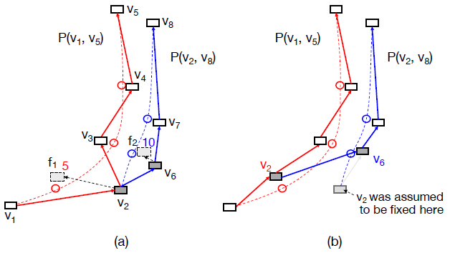
Anchor Placement
Anchor Cells
start of end point of a path
movable: contained in another segment & not the anchor of the segment
fixed: otherwise
Two paths compete for an anchor cell
v2: movable anchor for the blue path
Fix the anchor points
Figure(b)

Slide 11
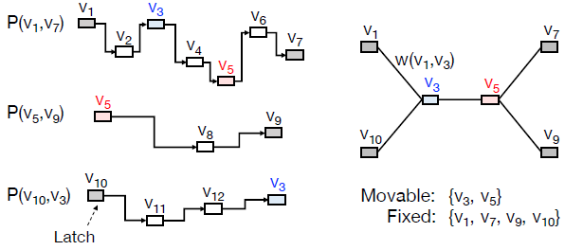

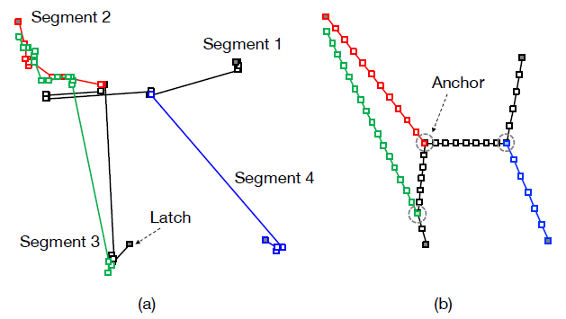

Anchor Placement
Construct placement graph
vertices are the anchors
an edge is created between a fixed anchor and a movable anchor if they belong to the same path segment
weight of an edge
Quadratic programming
Figure(a): before anchor placement
Figure(b): after anchor placement

Slide 12
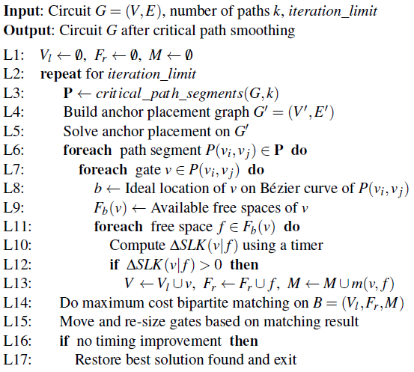
Algorithm Flow

Slide 13
Outline
Introduction
Problem Formulation
Experimental Results
Conclusion

Slide 14
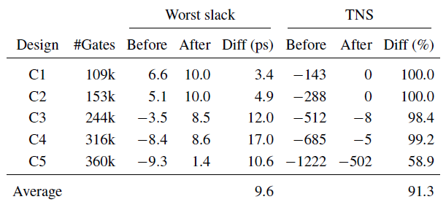
Experimental Results
Settings
Programming language: C++
An industrial static timing analyzer with sign-off accuracy
14nm circuits from commercial high performance microprocessor designs
Details
Clock period: 180ps
Slack threshold: 10ps
Iteration limit: 50
k: 10

Slide 15
Outline
Introduction
Algorithms
Experimental Results
Conclusion

Slide 16
Conclusion
Present a path-based incremental timing-driven placement algorithm called OWARU
Adopt Bézier curve smoothing to straighten out meandering timing critical paths
Provide a free space aware capability to guarantee a legal placement solution even without an explicit legalization step

Slide 17

Thank You!

